Slide 1

Hunt Museum Business Plan 2019
Changing Lives with Culture, Creativity and Learning

Slide 2
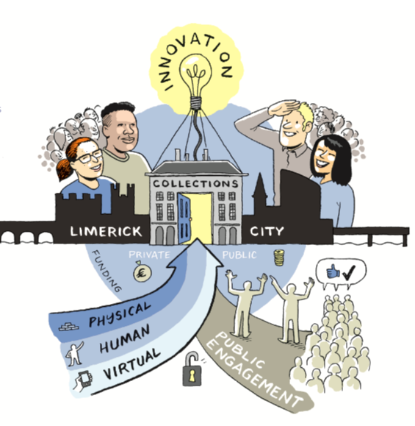
Staff Responsibility & Resource
Priorities:
Collections - led by Naomi + 1 FTE
Public Engagement:
Exhibitions - led by Naomi - 1 intern
Education - led by Maria - 1 assistant + intern
Community - led by Linda
Innovation - led by Jill (wikipedian vacancy)
Funding - led by Jill (and vacancy)
Support:
Administration & Exhibitions - vacancy
Finance: outsourced: Willie & Monica 6 d/m
Marketing - led by Julie + intern
Retail - led by Joni + 3 Front of house PTE
Docents - led by Joni
Friends - led by Julie + Jill
Website - led by Julie, intern & consultant
Total FTE = 9 + 3 PTE (approx 1 FTE) & 5 Interns
[2018 = 8 +3]

Slide 3

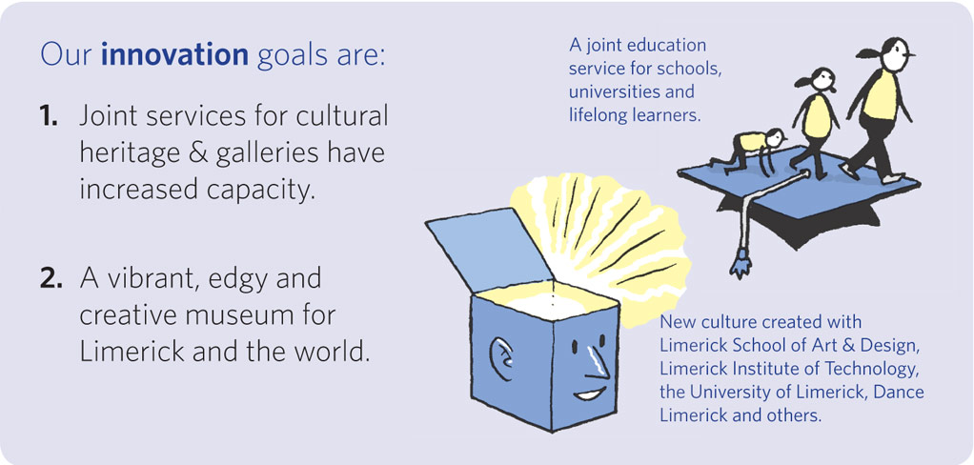
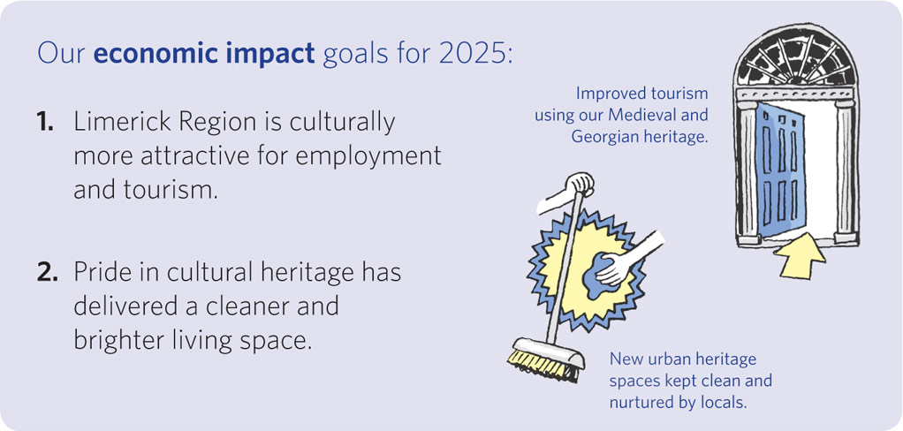
Our Strategic Ambitions:
By 2025 the Hunt Museum wants to have Impact in 3 areas:

Slide 4
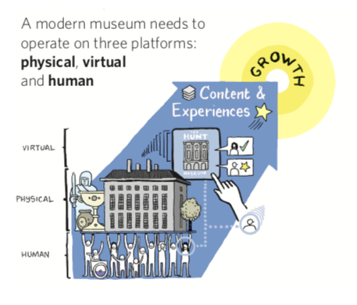
On three platforms
With three key actions per platform

Slide 5

The network
2019
1. Docents:
Safeguard the superior knowledge and volunteer help
Coordinate active projects: Research, Blogs, Dementia,
Labelling etc
2. Friends:
Expand membership of Friends from 380 subscriptions to 700, including 50 in Hunt Society
Campaign to raise funds linked to benefits of cultural heritage participation and improving of mental health
3. Partners: formalise our partner networks
a. Cultural heritage institutions
b. Education: universites, colleges and schools
c. Societal - mental health, dementia, prison families

Slide 6
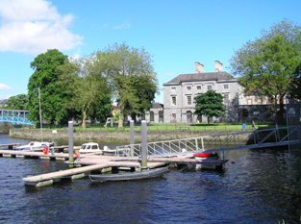
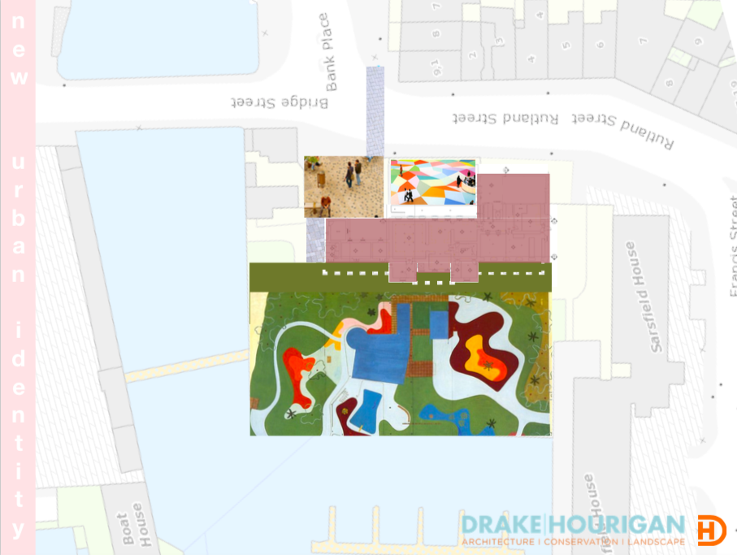
The building
2019
1. Upgrade the facilities using remaining DCHG grant
2. Raise funds to:
create a showcase gallery
change the garden
towards flipping the building
3. Engage visitors and increase participation in our collections and exhibitions.

Slide 7

Virtual
2019
Audience Development
1. Collection Digitisation:
Europeana Archaeology - key
objects digitised, some as 3D
2. Collection Management:
Set up Collection Management System
Docent team input images & improve
metadata
3. Online Presence:
Social media led upgrade of Website
Add collections to wikiCommons/Data

Slide 8
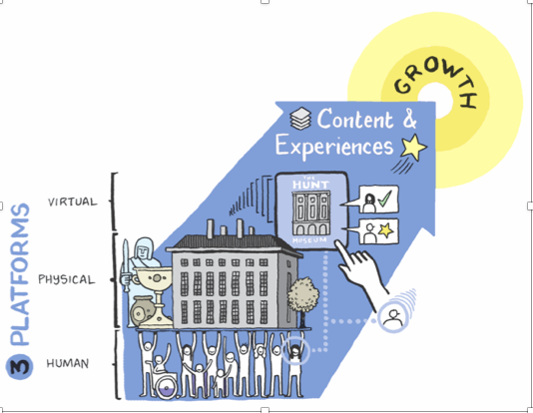
KPI’s for 2019
A number of KPI’s have been identified. Very deliberately not every task or action has a KPI.

Slide 9
Overall KPI’s
2019
1. Docents:
5 active Docent projects delivered in the year.
2. Friends:
380 subscriptions to 700, including 50 in Hunt Society
Raise €20K in non subscription funds
Partnership with Mental Health Charity
3. Partners: formalise our partner networks
10 formal partnerships set up.
4. Building:
Plan in place for upgrading of facilities
Funds of €40K raised for new showcase gallery
Funds of €50K raised and garden project commenced
5. Collection Digitisation:
400 objects digitised and uploaded to Europeana Archaeology

Slide 10
Overall KPI’s
6. Collection Management System
Implemented and all data records transferred
7. Online Presence
New website in place by September 2019
All qualifying data and objects uploaded to Wiki Commons
8. Events
Limerick Literary Festival
St Patrick’s Day 17 March
Limerick Fringe 4-7 April
Lifelong Learning 8-14 April
Limerick Soviet
Green Ribbon May
Riverfest - 2-6 May
Crinniu na nOg 15 June
Limerick LGBTQ Pride Festival
Heritage Week 17-25 August
Limerick Jazz Festival
Culture Night 20 September
Mental Health Week
Science Week 10-16 November

Slide 11
Priority 1 Collections KPI’s
2019
8 objects fully conserved
Interest in conservation increased measured by visitors leaving comments and online interest
Tours visiting the museum increasing by 20% from 2018 numbers
100 objects rendered as 3D Digitisations
10 objects printed at 2X human scale
New Tour Booklet published

Slide 12
Priority 2 Public Participation - KPI’s
Visitors
5% increase in visitors over 2017 figures
Each exhibition has an Event Brief.
Funds of €50K raised via dinner and sponsorship
Education
All tours reviewed - updated or binned
2 new tours up and running
New Limerick Medieval Trail programme for Heritage Week
Funding for joint museums programme
25% of Limerick Region schools have visited the Hunt Museum
3 Stop-motion workshops
Community
Volunteers continue to run Primary School Workshops when funding is finished
The Hunt Museum is recognised as a supporter of Mental Health Charity
Participation:
Hackathon is held
Community of 3D Digitisers exists

Slide 13
Priority 3 Innovation KPI’s
2019
Limerick Medieval Trail up and running by June 2019
Partnership with LightMoves
Joint Education service for museums up and running

Slide 14
Priority 4 Funding KPI’s
2019
Public Funds increase by 10%
20 patrons are signed up
Sponsorship database in place

Slide 15
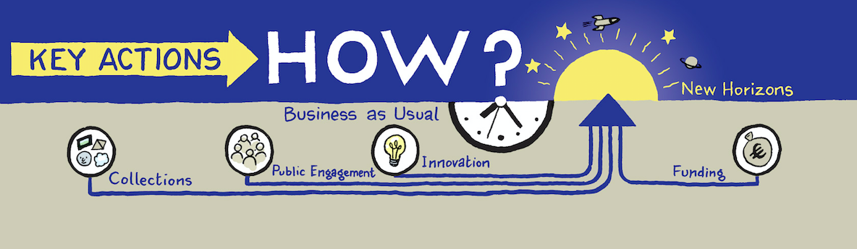
What does this mean for our 4 priorities:
Collections
Public Engagement
Innovation
Funding

Slide 16

Collections
Core collection conservation :
2 objects - Statues of Balthazar and Apollo and 6 items from the Ceramic collection in urgent need
Conservation on view: showing public how conservation is done.
Supported by:
Docents: Tours, Conservation training; Highlight Lectures
Education: School workshops and tours,
Marketing: Promote tours on tourism platforms, marketing plans for education activities; Share conservation online
Action 1: Continue our work to maintain and present all three Collections within the museum.
KPI’s: 8 objects fully conserved
Interest in conservation increased measured by visitors leaving comments and online interest
Tours visiting the museum increasing by 20% from 2018 numbers

Slide 17
Priority 1. Collections
Responsible: Naomi Timeline: January - September Budget: Gertrude Hunt Fund - cost €7k
T1.1 Conservation on View -
T1.1.1 Statues of Balthazar and Apollo
T1.1.2 Liaise with Wood Conservator dates for conservation Q1
T1.1.3 Apollo to be conserved on site for viewing by public Q2/Q3
T1.1.3 .1 Liaise with Marketing to promote all conservation work and on website
T1.1.4 Arrange transport of Balthazar to Conservator’s studio Q3
T1.1.5 Organise conservation workshop/talk for Docents and public when conservator on site Q2

Slide 18
Priority 1. Collections
Responsible: Naomi Budget: Gertrude Hunt Fund Timeline: April - September
T1.2. Conservation - conservation of 6 ceramic objects identified as urgent.
T1.2.1 Identify ceramic conservator April
T1.2.2 Liaise if work can be done in the museum on view to public or in studio Q2
T1.2.3 Liaise with Marketing to promote all conservation work and on website Q2-Q4
T1.2.4 Arrange packing and transport if required Q2-Q4
T1.2.5 Arrange conservation workshop/talk for Docents and public Q2-Q4

Slide 19
Collections
  Europeana Archaeology work
  New collection management system
    Add 2000 Hunt Museum Core Collection objects
  Identify and prepare 100 objects for 3D digitisation
Supported by:
Docents: Collection Management System
Education: 3 editathons to upload data to wikipedia and possible wikipedian in residence
Community: 3D digitisation group training & workshops, 3D scans made into 3D printed models
Marketing: Campaigns on each of digitise objects linked to blogs and object of the month
Funding: 3D printing garden objects
Action 2: Extend our reach through high quality digitisation, in particular 3D digitisation, and placing of the collections online, under open licenses and 3D printed versions of our objects for garden and street use..
KPI’s: 100 objects rendered as 3D Digitisations
10 objects printed at 2X human scale

Slide 20
Priority 1. Collections
Responsible: Naomi/Tori Timeline: end of February 2019 Budget: € Museum
Tasks
T1.3 Collection Management System
T1.3.1 Purchase Identify and purchase Collection Management System compatible with existing database - end of February 2019
T1.3. 2 Liaise and decide with IT Consultant re storage - cloud versus in house March 2019

Slide 21
Priority 1. Collections
Responsible: Naomi/Tori Timeline: March - December Budget: € Museum
T1.4.2 Implementation of CMS,
T1.4.2.1 Training to be provided and transfer of all existing information Q2
T1.4.2.2 Identify team of Docents willing to help transfer records from current systems and improve the data March
T1.4.2.3 Give training in metadata creation & identification of headings Q2
T1.4.2.4 Set aims and timeframes for implementation - 2000 core collection objects Q2
T1.4.2.4 Quarterly Progress Report on items transferred, improved, Q2-Q4
T1.4.2.5 Link to Website, ensuring all items are fully discoverable Q3

Slide 22
Priority 1. Collections
Responsible: Naomi/Tori Timeline: end of February 2019 Budget: € Museum
T1.5 Europeana Archaeology
Timeline: February 2019 - July 2020 Budget: Europeana Archaeology grant 75% - 25% matching funds from Hunt Museum - €33K- 2019
T1.5.1 Set-up project with deadlines and targets Q1
T1.5.2 Collate information and create high resolution images for each object Q2-4
T1.5.3 Add information to Hunt Collection Management System Q2-4
T1.5.4 Export to Europeana database under open licence Q4
T1.5.5 Progress reports (monthly)
T1.6 3D Objects
T1.6.1 Identify 100 objects for 3D digitisation in consultation with Education Department, connect to content being provided for Europeana Archaeology - linked to Task 3.4 Q 2
T1.6.2 Work with Marketing and Education to design & implement potential for Education programme Q3-4
Notes:
Added by Maria

Slide 23
Priority 1. Collections
Responsible: Naomi/Tori Timeline: Q2-Q4 Budget: € Museum
T1.7 Adding Collections to Wikipedia and WikiData
T1.7.1 Set-up project with deadlines and targets - Q3/4
T1.7.2 Run at least one wikieditathon wtih help from Ireland’s Wikipedian by end of 2019
Notes:
Added by Maria

Slide 24
Collections
Display: New cases for Irish Contemporary Ceramics
Redisplay and remodelling of 1st floor study room as a showcase
for upgrading rest of John & Gertrude Hunt Core Collection
Interpretation: new labelling, text panels, including timeline;
Supported by:
Docents: creating new interpretations and new tour booklet
Friends: Link Friends Lectures more closely to the Collections
Education: Collaborating to make Timeline curriculum based; Developing tours using timeline; Work with LSAD and UL MA Interactive Design Students for new interpretations of the Collections
Marketing: Promote tours
Retail Increase the amount of Contemporary Ceramics on sale, based on the works of Collection artists; Develop replications of twenty objects from the core collection for sale in the Gift shop and online.
Funding: Raise funds for new display cases and redisplay of showcase
Action 4: Improve and upgrade the display of our Collections, with more interpretation and a modernising of the look and feel for the visitor.
KPI: New Tour Booklet published

Slide 25
Priority 1. Collections
Responsible: Naomi Timeline: Q3-4 Budget: 24K to be raised
T1.8 Display
T1.8.1 New Cases for Irish Contemporary Ceramics
T1.8.1.1 Raise €24K by Q3
T1.8.1.2 Purchase new cases by Q4
T1.8.2. Redisplay and remodelling of 1st floor study room
T1.8.2.1 Create design for remodel by Q4
T1.8.2.2 Raise funds for remodelling
T1.8.2.3 Set-up project with deadlines and targets
Notes:
Added by Maria

Slide 26
Priority 1. Collections
Responsible: Naomi Timeline: February to July 2019 Budget: to be raised for interpretative tables
Tasks
T1.8 Display Cont/d
T1.8.3 Interpretation
T1.8.3.1 Project manage the delivery of a timeline, new labelling and text panels to improve interpretation in the museum with Docents Q1 and Q2
T1.8.3.2 Investigate digital interpretation tablets cost and implementation to - increase access to information about an object. Q3
T1.
Notes:
Added by Maria

Slide 27
Collections
For investigation only in 2019
Action 3: Through acquisition or collaboration expand the collections and remit of the Hunt Museum
Action 5: Initiate partnerships and strategic relationships with platforms and tech innovators such as Wikipedia, Europeana, Mozilla and Google to increase understanding of our Collections .

Slide 28

2. Public Engagement - Visitors
Action 1: A major exhibition every year, and 3 medium-sized exhibitions to entice visitors from far and wide and gain repeat visits to the museum.
Action 5:. Multiplication of our audiences through exhibitions in other venues and countries and active uploading of our collections online to international digital collections such as Europeana & the DP.LA.

Slide 29
2. Public Engagement - Visitors
Major Exhibition:
Sir John Lavery, William Leech and Walter Osborne 1 June - 7 October
Gallery Exhibitions:
Blurring the Edge to 20 January
Limerick Printmakers 20th anniversary exhibition 1 February - 22 April
Creative Arts by People in Custody 18 October - 24 November
Colin Davidson - collaboration with Oliver Sears Gallery, 6 December - 29 February 2020
Museum Exhibitions:
Visible Reminders of Invisible Light - 12 January - 28 February
Ingrid Hess kids exhibition on Prehistoric Ireland with Limerick City Museum - February
LSAD annual show throughout museum Mid March - Mid April
UL Interactive Design Students exhib -- May/June
Cafe Exhibitions:
Brian MacMahon showing works in cafe - 1 -30 April
Maurice Quillinan showing works in cafe -
Exhibitions External
  Investigate staging a Sybil Connolly Exhibition in the IHA in New York by end of 2019
  Investigate bringing the Van Gogh, Roderic O’Connor exhibition to Limerick in 2021/22
Notes:
This is the 2019 schedule

Slide 30
2. Public Engagement - Visitors
Supported by:
Docents: leading public tours of the exhibitions -
Education: Symposium Lavery, Osborne Summer Exhibition; Talks: Visible Reminders; 20th Anniversary of Printmakers; Limerick Prison Service - talks by resident artists who worked with prisoners; Workshops: Lavery/Leech Plein Air event - July, Schools Interpretative Workshops for Lavery/Leech - June and September, Invisible reminders - February, Ingrid Hess - Prehistoric Ireland - handling & Ancient Ireland Loan Box,
School Tours: Develop and implement tours for each exhibition aiming to attract 5-10 schools for the Gallery and Museum exhibitions and 30-50 for the Major Gallery Exhibition
Ingrid Hess - Prehistoric Ireland - Schools Tour, ‘Walk in My Shoes’ programme with
Narrative 4; Kids Curator Programme developed and delivered for Lavery/Leech conducting mini tours
Retail: Stock books, catalogues, stock relevant to the Exhibitions
Marketing: For each exhibition prepare a specific MarComms Plan, request and communicate a press release and deliver appropriate PR including mass and social media, produce flyers/posters for distribution & incorporate in the event guide, add details to the Hunt Museum website and social media platforms
Funding: Fundraising Dinner and Event June 2019 - coinciding with opening of Summer
Exhibition; sponsorship is needed for the exhibition. Friends to support.
KPI’s: 5% increase in visitors over 2017 figures
Each exhibition will have an Event Brief.
Funds raised via dinner and sponsorship of @50K

Slide 31
Priority 2. Public Engagement - Visitors
Responsible: Naomi Timeline: Jan-Oct 2019 Budget: Operating Budget 60K Sponsorship 4OK
T2.1 Major Exhibition: Summer Exhibition: Lavery,Osborne…………... 1 June to 7 October
T2.1.1 Preparation
. T2.1.1.1 Finalise selection of works
T2.1.1.2 Agree conditions of loans with lenders/Institutions
T2.1.1.3 Prepare all documentation, Letters of request to lenders, loan agreements, Insurance etc
T2.1.2 Prepare Facilities Report & Security Report for National Cultural Institutions
T2.1.3 Apply for funding from Dept. Culture for indemnity for works outside the state February
T2.1.4 Exhibition installation: Arrange building of crates/TFrames, Transport and Installation of exhibition May
T2.1.5 Publicity: Prepare all info for publicity, banner, pop up, posters, flyers etc. April

Slide 32
Priority 2. Public Engagement - Visitors
Tasks Naomi
Summer Exhibition: Lavery, Leech, Osborne ctd…
Catalogue: Timeline: March - April
T2.1.6 Catalogue
T2.1.6.1 Exhibition Design and Catalogue - Select March
T2.1.6.2 Select art historian and provide exhibition brief February
T2.1.6.3 Research and write text for individual works (Docents) and write guide for Docents
for tours April
T2.1.6.4 Prepare all info for catalogue for designer/printer April/May
T2.1.6.5 Copyright - IVARO Jan-Feb

Slide 33
Priority 2. Public Engagement - Visitors
Tasks Naomi
Summer Exhibition: LAVERY, OSBORNE
T2.1.7 Gallery Layout & Installation, Training & Invigilation
Timeline: May
T2.1.7.1 Build wall and prepare gallery for exhibition, security/alarms May
T2.1.7.2 Delivery of work - examination of works or arrival & write condition reports May
T2.1.7.3 Layout and installation May
T2.1.7.4 Install text and graphic panels May
T2.1.7.5 Write Guide and train Docents April/May
T2.1.7.6 Prepare Invigilation roster for Docents, Interns, Volunteers May
KPI’s - Number of visitors and media mentions, sponsorship and income generated

Slide 34
Priority 2. Public Engagement - Visitors
Tasks Naomi
T2.2 : Gallery Exhibitions Budget: €30,000 Museum shared with Museum & Cafe Exhibitions
T2.2.1 Limerick Printmakers 20 Anniversary exhibition 1 Feb- 22 April
T2.2.1.1 Liaise with Printmakers on promotional/publicity material, delivery of works and installation
T2.2.1.2 Liaise with Marketing on publicity
T2.2.1.3 Opening reception - 14 February
T2.2.2 Creative Arts by People in Custody 18 October to 24 November
T2.2.2.1 Liaise with xxxx for promotional/publicity material, delivery of works and installation
T2.2.2.2 Liaise with Marketing on publicity
T2.2.2.3 Opening reception - October 24

Slide 35
Priority 2. Public Engagement - Visitors
Tasks Naomi
T2.2 : Gallery Exhibitions contd Budget: €30,000 Museum shared with Museum & Cafe Exhibitions
T2.2.3 Colin Davidson - collaboration with Oliver Sears Gallery 6 December to 29 February 2020
T2.2.3.1 Liaise with Oliver Searsfor promotional/publicity material, delivery of works and installation
T2.2.3.2 Liaise with Marketing on publicity
T2.2.3.3 Opening reception - December 12
KPI’s - Number of visitors and press mentions

Slide 36
Priority 2. Public Engagement - Visitors
Tasks Naomi
T2.3 : Museum Exhibitions Budget: €30,000 Museum shared with Museum & Cafe Exhibitions
T2.3.1 Visible Reminders of Invisible Light - 24 January to 28 February
T2.3.1.1 Prepare publicity & promotional material
TT2.3.1.2 Deliver works Fri 14 Jan, Install exhibition Monday 21 Jan
T2.3.1.3 Liaise with Marketing re publicity - Opening by Bishop Brendan Leahy 24 January
T2.3.2 Ingrid Hess kids Exhibition - February - Education Wing
T2.3.2. 1 Prepare publicity & promotional material
T2.3.2.2 Install exhibition Monday 28 Jan
T2.3.2 .3 Liaise with Marketing & Limerick Museum re publicity
KPI - number of visitors on opening nights

Slide 37
Priority 2. Public Engagement - Visitors
Responsible: Naomi
Tasks
T2.3 : Museum Exhibitions cont/d Budget: €30,000 Museum shared with Museum & Cafe Exhibitions
T2.3.3 Limerick School of Art & Design Annual Show - Mid March to mid April
Opening night 28 March
T2.3.3.1 Tutors and students do all publicity and installation of exhibition with member of collection team and marketing
T2.3.3.1 Prepare publicity & promotional material, with students and teachers
T2.3.3.2 Deliver works and Install exhibition with students and tutors 25 March
T2.3.4 UL Interactive Design Students Exhibition May/June
T2.3.4.1 Prepare publicity & promotional material
T2.3.4.2 Deliver works xxx Install exhibition xxxx with students and tutors
T2.3.4.4 Liaise with Marketing re publicity - to be done by students and tutors.
Opening night to be agreed.

Slide 38
Priority 2. Public Engagement - Visitors
Tasks Naomi
T2.4 : Cafe Exhibitions Budget: €30,000 Museum shared with Museum & Cafe Exhibitions
T2.4.1 Brian MacMahon 1-30 April T2.3.3.1 Prepare publicity & promotional material
T2.4.1.1 Deliver works 26 March and Install exhibition 27/28
T2.4.1.2 Liaise with Marketing re publicity
T2.4.2 Maurice Quillinan works
T2.4.2.1 Prepare publicity & promotional material
T2.4.2.2 Deliver works xxx Install exhibition xxxx
T2.4.2.3 Liaise with Marketing re publicity
KPI - number of works sold

Slide 39
Priority 2. Public Engagement - Visitors
Tasks Naomi
T2.5 : External Exhibitions
T2.5.1 EIB Collection to Limerick
T2.5.1.1 Set up with LCC&C a Steering Group for wider event of bringing Europe to Limerick in 2020 - February 2019
T2.5.1.1 Create overall budget of funding required - March 2019
T2.5.1.2 Set up advisory committee for the exhibition - February 2019
T2.5.2 Sybil Connolly and Jewellery in New York
T2.5.2.1 Investigate feasibility, venue, finance etc of exhibition in NY IHA by end of 2019/beginning 2020
T2.5.3 Van Gogh/Roderic O’Connor exhibition for 2021/22
T2.5.3.1 Investigate feasibility, venue, finance etc of bringing Van Gogh Museums Roderic O’Connor exhibition to Limerick or similar

Slide 40
2. Public Engagement - Education
Action 2. Toddlers, preschool, 5-11, 12-18 age groups and lifelong learners continue to benefit from our schools and academic programmes.
Action 6. Collaborate and lead the cultural heritage education programme for the region, with every school visiting at least once per year.

Slide 41
2. Public Engagement : Education
Tours & Workshops for Schools according to age group:
    Toddlers - Play for Toddlers - until February
    5-11 - Primary schools curriculum based exhibition tours and workshops, such as ‘All About the Hunt’, ‘Animal Hunt’ , Permanent Collect Tour, 800 Years of Fashion, Ancient Ireland and Viking object handling sessions; Curriculum based outreach loan box workshops on the Vikings, Archaeology, Ancient Ireland and the local community histories celebrated through Communities of Cultures. Kids Mid-term, Easter and Summer camps; Exhibition workshops
    12-18- Post primary curriculum based including Permanent Collection tours, Art Appreciation and Comprehension, Art, Craft and Design Through the Ages, Reading Twentieth-Century Irish Art, Exhibition Layout & Design, Temporary exhibition tours and workshops; Transition year programmes (including Gaisce) and placements
    Lifelong Learners - Permanent Collection tours; Public programming for temporary exhibitions including tours, lectures, and events and Heritage Week ( August)
Review and update curriculum linked tours and decide which to retire, develop new ones including an archaeology tour, a plain speaking art tour for Leech/Lavery; a migration tour and an interactive role play game, new media such as stop motion deployed for workshops
KPI’s: All tours reviewed - updated or binned
2 new tours up and running
25% of Limerick Region schools have visited the Hunt Museum
3 Stop-motion workshops
Notes:
Double the number

Slide 42
2. Public Engagement : Education
Set up joint museums programme for 19th-21st Century Art
National Weeks: Heritage week, Science week
  Heritage Week new programme linked to Medieval Limerick
  Science Week explore partnership with ESB
Continued Professional Development: Art teacher CPD in Junk Kouture - September
Supported by:
Docents: collection and exhibition tours for all age groups; with school workshop subgroups Marketing: Revising the branding of all Education
Set up templates for Education to use to promote workshops, collection and temporary exhibition tours
Promote kids camps
Create and execute campaigns for Heritage and Science Weeks.
Create and deliver joint promotion campaign on medieval Limerick with St John’s Castle and St Mary’s Cathedral
Funding
Find funding for joint museums education programme
ETB and other grants from Creative Ireland etc. Limerick3D - possible funding source Resilient Communities Fund
Friends support
KPI’s: new Limerick Medieval Trail programme for Heritage Week
Funding for joint museums programme

Slide 43
Priority 2. Public Engagement - Education
Responsible: Maria Date: Jan to September 2019 Budget: Education
T2.6 inreach Primary school workshop programmes
T2.6.1 Tours to review: Timeline: Q1 & Q2 2019
T2.6.1.1 Adjust and decide to keep or bin tours: a. All About the Hunt, b. Animal Hunt’ tour. (See Siobhan English’s feedback) c. Permanent Collection tour Q1
T2.6.1.2 Update tours keeping in line with curricula and train Docents on changes Q2
T2.6.1.3 Set-up and deliver promotion campaign for both old and new tours end Q2-Q4
T2.6.1.3 Deliver revised tours aiming for 1 per week, Sept-November
T2.1.3 …..

Slide 44
Priority 2. Public Engagement - Education
Responsible: Maria Date: Jan to September 2019 Budget: Education
T2.6 inreach Primary school workshop programmes
T2.6.2 Research & implement 2 new tour:
Ancient Ireland archaeology tour of collections, Timeline: Q1-Q2, 2019
T2.6.2.1 Deliver Ancient Ireland tour & handling session scripts - Jan 2019
T2.6.2,2 Deliver Ancient Ireland/Ingrid Hess exhibition workshop programme to 3rd & 4th classes 2 per week from February to end March 2019.
T2.6.2.3 Evaluate and consider extension of programme.
Ceramics and Pottery - contemporary and ancient pilot Timeline: Q1
T2.6.2.3 Create a Ceramics/Pottery tour/workshop connected to the ICCC collection and objects in the Hunt Collection. February
T2.6.2.4 Deliver Docents script and train for the session February
T2.6.2.5 Deliver 10 class pilot with Our Lady Queen of Peace Primary School March/April
T2.6.2.6 Evaluate and decide whether to offer as new tour in Autumn term
T2.6.3 Evaluate all tours and adjust for 2020 - Q4
T2.1.3 …..

Slide 45
Priority 2. Public Engagement - Education
Responsible: Maria Timeline:: 2019 Budget: Education
T2.7. outreach Primary school workshop programmes
T2.7.1 Review, improve or abandon 3 workshops: January/February 2019
T2.7.1.1 Review and adjust ‘800 Years of Fashion’ interpretative script and activity based resources
T2.7.1.2 Review and adjust Viking Loan Box script, activity based resources and teacher notes
T2.7.1.3 Review and adjust Archaeology Loan Box script, activity resources and teacher notes
T2.7.2 Recruit and deliver training with Docents on the above programmes March 2019
T2.7.3 Promote and deliver workshops - 1 per week April-June, September- November
T2.7.4 Evaluate results and revise for 2020

Slide 46
Priority 2. Public Engagement - Education
Responsible: Maria Timeline:: April to end of September 2019 Budget: Education
T2.8 Lavery & Osborne Exhibition workshops -
T2.8.1 Primary
T2.8.1.1 Identify and confirm curriculum links and learning for this workshop April
T2.8.1.2: Research and script a plain speaking tour of art works on display April
T2.8 .1.3 Design and prepare the activities to take place during this workshop April
T2.8.2 Post Primary Schools
T2.8.2.1 Identify and confirm curriculum links and learning objectives for this workshop April
T2.8.2.2 Research and script a plain speaking tour of art works on display April
T2.8.2.3 Design and prepare resources to support student responses to art works April
T2.8.3 Purchase necessary art supplies and equipment to support delivery, including digitally capturing students verbal responses , for T2.8.1 and T2.8.2
Notes:
Added by Maria

Slide 47
Priority 2. Public Engagement - Education
Responsible: Maria Timeline:: April to end of September 2019 Budget: Education
T2.8 Lavery & Osborne Exhibition workshops Cont/d
T2.8.4 Liaise with marketing to promote this learning opportunity to primary & post-primary schools April
T2.8.5 Recruit and train Docents to lead and/or support delivery of Primary & Post-primary workshops
April
T2.8.6 Coordinate bookings and allocate staff and or volunteers for delivery, Average of 3 schools per week May-September
T2.8.7 Evaluate workshops Q4
Notes:
Added by Maria

Slide 48
Priority 2. Public Engagement - Education
Responsible: Chelsea Date: Jan to September 2019 Budget: Ireland Funds
T2.9 Develop Interactive Migration Game based on role play and storytelling Q2, 2019
T2.9.1 Run series of story telling sessions / role plays with primary and post-primary schools linking child’s migration story to an object in the collection
T2.9.2 Involve UN Live Museum in some interactive play session 4 over 2 days
T2.6.3 Analysis and rethink based on input and work done.
T2.6.4 Develop a role play game(s) for the museum, that might be used by the UN Live Museum elsewhere.
T2.6.5 Promote the game to schools, aiming to run 1 every week from Sept-Nov
T2.6.6 Plan and deliver training to Docents to deliver programmes including new ones
Q2 2019
T2.6.7 Evaluate results of Game and adjust for 2020 - Q4
T2.1.3 …..

Slide 49
Priority 2. Public Engagement - Education
Responsible: Maria Timeline:: 2019 Budget: Education
T2.10 Post Primary inreach
T2.10.1 Tours to review: Timeline: Q1 & Q2 2019
T2.10.1.1 Review Junior Cycle programmes including scripts and activity resources for Permanent Collection tour, ‘Art Appreciation and Comprehension’ and ‘Irish Art, Craft and Design through the Ages’.
T.2.10.2 Review Leaving Certificate programmes including ‘20th Century Irish Art and European Art’, ‘Irish Art’, Craft and Design through the Ages’ and ‘Exhibition Layout and Design’
T2.10.1.3 Update tours keeping in line with curricula March
T2.6.1.3 Deliver revised tours aiming for 1 per week April to June, Sept-November
T2.10.2 New Junior Certificate tour
T2.10.2.1 Research and deliver new exploring the work of an archaeologist and using archaeology as evidence. March
T2.10.3 Recruit and train Docents on above revised programmes and new tours April

Slide 50
Priority 2. Public Engagement - Education
Responsible: Maria Timeline:: 2019 Budget: Education
T2.11. Outreach Post-Primary school workshop programmes
T2.11.1 Review, improve or abandon 3 workshops: January/February 2019
T2.11.1.1 Review and adjust ‘800 Years of Fashion’ interpretative script and activity based resources
T2.11.1.2 Review and adjust Viking Loan Box script, activity based resources and teacher notes
T2.11.1.3 Review and adjust Archaeology Loan Box script, activity resources and teacher notes
T2.11.2 Continue to pilot Ancient Ireland (ICTeens) digital resource PHASE I with 1st years and TYs
T2. 11.2.1 Recruit and work with a new group of MA technical design students from UL to implement required changes to the ICTeens digital resource ( February to August)
T2.11.2 Recruit and deliver training with Docents on the above programmes March 2019
T2.11.3 Promote and deliver workshops - 1 per week April-June, September- November
T2.11.4 Evaluate results and revise for 2020

Slide 51
Priority 2. Public Engagement - Education
Responsible: Maria Timeline:: 2019 Budget: Education
T2.12 Heritage and Science Weeks.
T2.12.1 Heritage Week
T2.12.1.1 Create new programme for Heritage Week linked to Limerick Medieval Trail Q2
T2.12.1.2 Work with marketing to promote the programme July
T2. 12.1.3 Deliver the programme August
T2.12.2 Science Week
T2.12.2.1 Create a programme concept related to climate change and object(s) in the museum - January
T2.12.2.2 Investigate sponsorship from ESB for Science Week, February
T2.12.2.3 Work out how to deliver the programme for Science Week - September
T2.12.2.4 Deliver the programme - November
T2.12.2.5 Promote with UNLive Museum from October
92

Slide 52
Priority 2. Public Engagement - Education
Responsible: Maria Timeline:: January to May, September to December 2019 Budget: Education
T3.1 Opportunities for Transition Year Students
T3.1.1 Programme and facilitate a maximum of 8 TY student placements throughout the year
T3.1.2 Walk in my Shoes’ Programme
T3.1.2.1 Identify and secure funding or sponsorship to support the TY ‘programme
T3.1.2.2 Recruit TY students for ‘Walk in My Shoes’ workshops to be delivered as part of ‘Creative Arts by People in Custody Prison Art’ exhibition programme (Oct/Nov)
T3.1.2.3 Plan and deliver ‘Walk in My Shoes’ workshop programme in partnership with Narrative 4
T3.12.4 Document student interactions and responses to Prison artworks and their experiences in N4 workshop

Slide 53
Priority 2. Public Engagement - Education
Responsible: Jill Timeline:: 2019 Budget: LCC&C and grant funding
T3.2 Set up joint service with Limerick Museum and Limerick City Art Gallery as a pilot
T3.2.1 Source funding against proposal - Q1
T3.2.1 Develop pilot project plan with Limerick Museum, Limerick Gallery, Limerick Library Q2
T3.2.3 Implement plan: recruit educator, create final programme, gain traction from schools & lifelong learners Q3
T3.2.4 Run pilot Q4
T3.2.5 Evaluate pilot Q4
.
Notes:
Added by Maria

Slide 54
Priority 2. Public Engagement - Education
T2.8 CPD in Junk Kouture for Post Primary Schools Art Teachers
Budget: via the Art Teachers Association of Ireland ( ATAI)
Date: Saturday in September ( 09.30am to 4pm)
T2.8.1 Prepare and issue contact to Ruth Duignan for workshop planning and delivery
T2.8.2 Agree with Ruth how the CPD will link to the Collection
T2.8.3 Revise the 2018 Junk Kouture information produced last year on Key Skills and Statements of Learning and update where necessary.
T2.8.4 Use this information to produce a promotional poster and send to ATAI for circulation to their members
T2.8.5 Manage bookings
T2.8.6 Confirm catering with the Hunt Cafe
T2.8.7 Gather written evaluation and visually document this workshop

Slide 55
Priority 2: Public Engagement - Education
T3.3 Lavery, Osborne Symposium Timeline: Jan to June 2019 Budget: TBC
T3.3.1 Work out Budget and secure funding to cover speakers fees/ expenses
( Creative Ireland?)
T3.3.2 Confirm Symposium date in June and schedule with speakers, book the Captains’ Room
T3.3.3 Create Event Brief to include:
Book hotel accomodation for speakers, Obtain speaker bios and abstracts for Symposium publicity materials, confirm IT speaker needs, catering with Hunt Cafe, Interns to prepare Symposium packs, Room setup for event ( including IT), Agree ticket pricing for Docents, Friends, General Public, students and issue invites to VIPs
Liaison with Marketing to design and circulate publicity materials targeting key audiences
T3.3.4 Request Front of house staff manage Symposium bookings via online booking system - connected to EPOS, and Front of House ticket sales. Front of house to manage bookings.and Interns to oversee Symposium registration on the day

Slide 56
Priority 2: Public Engagement - Education
Temporary exhibition programming- Lavery, Osborne
T2.10 Plein Air event
Date: June 2019
Budget: Education/workshops
T2.10.1 Agree the parameters of this event with Management ( ticketed, free etc)
T2.10.2 Identify and contact suitable locally based artists to contribute to this event
T2.10.3 Agree artist fees if required
T2.10.4 Book Mayor to open event
T2.10.5 Agree access to marquee or arrange an alternative covered space outside
T2.10.6 Agree tour times and promote as part of this event as part of the wider exhibition programme
T2.10.7 Book Docents to deliver Lavery, Osborne exhibition tours
T2.10.8 Invite families from regeneration areas and Limerick Mental Health to attend.
T2.10.9 Purchase equipment and art supplies ( if required)
T2.10.10 Book photographer and/or videographer to capture artist and general public vox pop
T2.10.11 Event delivery - set up ticket and information desk, signage and branded publicity materials in the garden

Slide 57
2. Public Engagement : Community
Action 3. Community outreach with partners for mental health, dementia, Travellers, Migrants, Refugees, prisons and families and local communities.

Slide 58
2. Public Engagement : Community
Limerick 3D Project: using a group of volunteers to digitise and publish the collection as 3D objects.
Communities of Culture ‘Loan Box project’ - Recruit and train a team of Community facilitators from Limerick regeneration areas to deliver primary school workshops in north and southside schools
Mental Health Campaign: Develop a Hunt Museum based activity that resonates with Mental Health Week 2019; Deliver a monthly activity, such as gardening or conservation with Limerick Mental Health - starting from June 2019
Dementia : In House programme for people living with dementia and their family/carers; Outreach to Social Clubs for people living with dementia and their carers
Prison and Prison Families: link Creative Arts by People in Custody with Bedford Row

Slide 59
2. Public Engagement : Community
Supported by:
Education: School Workshop sessions with CofC Facilitators Jan 2019; Teacher Resource Material for Teacher Training March/April 2019
Docents: helping in Dementia, Mental Health & Kids Arts/Crafts programmes
Marketing: Schools flyer for Communities of Culture; MarComms Plan for Mental Health week Friends: Year long activism and fund raising campaign with Hunt Society volunteers to promote the benefits of culture heritage and participation for mental health
Funding: Communities of Culture funding granted - LCCC Regeneration to May 2019. Set up link to Mental Health Charity to raise funds for the Charity and the Museum’s activities
KPI’s: Volunteers continue to run Primary School Workshops when funding is finished
The Hunt Museum is recognised as a supporter of Mental Health Charity

Slide 60
Priority 2. Public Engagement - Community
Responsible: Linda Timeline:: Jan-May Budget: Social Intervention Fund (LCCC) €27k
T3.5 - Communities of Culture
T3.5.1 Complete Loan Box workshop training with the recruited Community Facilitators Jan/Feb
T3.5.2 Confirm Outreach bookings in schools and a schedule for Community Facilitators created and agreed. Jan/Feb
T3.5.3 Coordinator to pilot outreach workshops with input from Community Facilitators Feb/March
T3.5.4 Prepare learning materials to be used by Community Facilitators in two teacher training sessions - March 2019
T3.5.5 Community Facilitators take over delivery of outreach workshops in primary schools. Additional training to be provided where necessary. Feb to April
T3.5.6. Plan Limerick Lifelong Learning Week with Community Facilitators including confirmation of community venues and the participation of Northside and Southside communities in exchange events - 8th to 14th April.
T3.5.7 Work with Marketing to promote results of project and Lifelong Learning week. April/May
T3.5.8 Write up report for SIF - May

Slide 61
Priority 2. Public Engagement - Community
Responsible: Maria Timeline:: Jan-Feb 2019. Budget: 2,500 - balance of SIF fund
T3.6. Play for Toddlers Timeline:
This will be coordinated only until February 2019 - ABC Start Right have been asked to continue.
T3.6.1. SIF Workshops: Liaise with Julie Tiernan and Joanne Williams on dates in February for Knockalisheen
T3.6.2 Deliver block 2 ( four sessions) with young families residing in Knockalisheen by end of February
T3.6.2 Host ABC Start Right and PAUL Partnership programming for young families in the Museum

Slide 62
Public Engagement Community
Responsible: Joni Timeline:: 2019. Budget: Museum
T3.7 Dementia programme
T3.7.1 Create full plan with Docents dates for in-house and Outreach delivery.Q1
T3.7.2 Design an information point and display for Dementia programme with Marketing by April 2019
T3.7.3 Further training- Moma on-line course- Interactive Strategies for Engaging in Art Q1 & Q2
T3.8 Monthly Kids Arts and Crafts Club
T3.8.1 Work with Docents to come up with arts and crafts connected to objects in collection
T3.8.2 Deliver monthly Sunday sessions Q1-Q4

Slide 63
Public Engagement Community
Responsible: Jill/LMHA/Friends Timeline:: 2019. Budget: Raised Funds
T3.9 Mental Health Collaboration
T3.9.1 Develop with Limerick Mental Health Association Volunteers, a museum participation activity led programme (link to Friends work to create joint projects) by March 2019
T3.9.2 Create Activity plan with LMHA, Docents and Friends and other stakeholders February
T3.9.3 Create overall plan linked to Green Ribbon, Mental Health Week and regular meet -ups by mid March 2019
T3.9.4 Green Ribbon Month - plan with the activities for the month connected to Friends fundraising campaigns
T3.9.5 Mental Health Week plan with Limerick Mental Health Association the activities for the month connected to Friends fundraising campaigns
*Activities for Docents and Staff 13-19 May ‘19

Slide 64
2. Public Engagement - Participation
Action 8: A social media led development of our web presence, where our interactions with our online audiences are vibrant and continuous.
Action 10: Public participation events to increase our knowledge and improve the description of our Collections on our own websites and in Wikipedia, via Wiki-Editathons etc.
Action 12: Interactive events such as hackathons, editathons, 3D digitisation and Collection days to give more people the opportunity to contribute to our social and economic impact.
Notes:
Our actions for Public Engagement Participation are three - Translating to

Slide 65
2. Public Engagement : Participation
In addition to the participation activities described above sections the following tasks are scheduled for 2019
Continue to develop the Limerick 3D community and set up a programme of 3D digitisation.
Use all social media platforms to increase audience reach and engagement with the Collections and Events
Run a hackathon with @LIT and @UL linked to Coding Da Vinci to generate new technology for the museum
Develop volunteer groups within Hunt Friends and Society to run participation activities including Vlogging about museum and our objects.
Supported by:
Education: structuring activities that contribute to curricula and lifelong learning
Docents: volunteering and helping where needed
Friends: actively promoting and participating in events
Community: encouraging a wide range of people to join in and gain from the participation
Marketing: promoting all the events to target audiences.
KPI’s: Hackathon is run
Community of 3D Digitisers exists
Notes:
The following tasks

Slide 66
Priority 2. Public Engagement - Participation
Responsible: Maria Timeline:: Q1-Q4 Budget: €15K 3D Digitisation from Museum Budget
T4.1 Limerick3D Additional External funding also required
T4.1.1 Support Volunteer 3D object recording and processing on Wednesdays, Fridays and one Saturday a month starting xx
T4.1.2 Work with Collections for Europeana Archaeology to identify 100 objects for 3D Digitisation and create a schedule with the volunteers and Digital Heritage Age - Q1
T4.1.3 Purchase and download an additional copy of Agisoft to meet demand for processing outside Volunteer sessions in the Museum. February
T4.1.4 Liaise with Digital Heritage Age to agree a plan to manage unprocessed/problematic object files and work out how to digitise the axeheads. February
T4.1.5 Volunteers, recruit new from waiting list, and plan March top up training for existing Volunteers March-May
T4.1.6 Scope opportunities and costs for 3D printing digital models, including liaising with Fab Lab - March
T4.1.7 Work on next tranche of funding for the project…. Grant applications or Sponsorship Q2
Notes:
Added by Maria

Slide 67
Priority 2. Public Engagement - Participation
Responsible - Julie Timeline:: Q1-Q4 Budget: Museum
T4.2 Use all social media platforms to increase audience reach and engagement with the Collections and Events
T4.2.1 Review current use of social media platforms February
T4.2.2 Create plan for use of social media platforms with targets February
T4.2.3 Execute plan, reporting progress quarterly and adjusting where needed Q1-Q4

Slide 68
Priority 2. Public Engagement - Participation
Responsible: Jill Timeline:: Q2-3 Budget: Museum and Corporate Sponsor
T4.5 Run a hackathon with @LIT and @UL linked to Coding Da Vinci to generate new technology for the museum
T4.5.1 Set up concept and agree dates with LIT & UL & Coding Da Vinci March
T4.5.2 Involve Docents using concept of improving display, Q2
T4.5.3 Hold Hackathon and hold Prize ceremony Q2

Slide 69

3. Innovation : Partnerships
Create a Limerick Medieval trail.
Together with St Mary’s Cathedral, King John’s Castle, the Limerick Civic Trust, Limerick City and County Council and local residents
Supported by:
Collections: identifying the relevant objects
Community: making large-scale 3D printed versions of Hunt Museum objects for the trail and our garden
Marketing: working with Tourism platforms and Failte Ireland to promote the trail and the connection to the Museum.
Funding: raising funds for 3D digitisation & printing
Action 1: Work with other Limerick and regional attractions to increase awareness and use of the city’s heritage to the benefit of inward investment and tourism.
KPI: Limerick Medieval Trail up and running by June 2019
Notes:
Whereas under our priority Innovation we are aiming to to Create A Medieval trail

Slide 70
Priority 3. Innovation - Partnerships
Responsible: Jill Timeline:: Q2-3 Budget: Museum and other Stakeholders
T4.6 Create a Limerick Medieval trail with other stakeholders
T4.6.1 Set up with stakeholders a first version of the Limerick Medieval Trail by end March
T4.6.2 Print versions of trail for distribution around city - April
T4.6.3 Incorporate trail into all tourism related sites, connect it to Failte Ireland etc April
T4.6.4 Review trail and set up improvement plan for 2nd version (consider further research with archivists and the use of an existing app to August
T4.6.5 Create new version of trail - November

Slide 71
3. Innovation : Partnerships
Extend the Creative Partnerships on Art, Fashion and Design and develop a HuntStudio similar to the RijksStudio.
Actively engage with screen based media to reach new audiences with the Collections.
Supported by:
Collections: connecting to our displays
Education: supporting the interpretation and work of the schools. Developing our Stop Motion Workshops as educational tools to engage students.
Marketing: creating a new #HuntStudio brand and competition; promoting the outcomes of the stop motion workshops.
Funding: raising sponsorship
Action 2: Collaborations with University of Limerick, Limerick Institute of Technology and Limerick School of Art and Design.
Action 4: Collaborate with more cultural organisations to deliver new experiences such as Lightmoves Screen Dance or Crinniù na nOg.
KPI’s: Partnership with LightMoves
Notes:
But also

Slide 72
Priority 3. Innovation - Partnerships
Responsible: Jill/Maria Timeline:: Q2-3 Budget: Museum
T4.7 Extend the Creative Partnerships on Art, Fashion and Design and develop a HuntStudio similar to the RijksStudio.
T4.7.1 Work our what is needed to set up the Hunt Studio with partners by September
T4.7.2 If viable, set up for 2020 Business Plan
.

Slide 73
Priority 3. Innovation - Partnerships
Responsible: Chelsea Timeline:: Q2-3 Budget: Museum, Lightmoves & Schools
T4.8 Actively engage with screen based media to reach new audiences with the Collections.
Lightmoves
T4.8.1 Create an MoU with Lightmoves festival to work on a schools programme and competition using screen based media, the Hunt collections and dance. June 2019
T4.8.2 Use the TY/Leaving Cert Programmes to engage schools. Look at other international film competitions for students (make contact with these coordinators to learn from them and gain knowledge, go to one competition as a site visit experience to see how another organisation runs theirs). September 2019
T4.8.3 Engage with the UL/LIT/LASD Film, Dance and Animation Departments to offer a training/taster day(s) for the students and jointly set up the workshops and teams with schools September
T4.8.4 Run 12 workshops in October with 12 different schools and volunteer teams - complete films to be shown at Lightmoves festival in November. Competition for best x.y.z with Awards. October/November
T.4.8.5 Review and improve for the following year December 2019

Slide 74
Priority 3. Innovation - Partnerships
Responsible: Chelsea Timeline:: Q2-3 Budget: Museum & Crinniu na nOg & Schools
T4.9 Actively engage with screen based media to reach new audiences with the Collections Cont/d.
Crinniu na nOg
T4.9.5 Use stop-motion and video to engage primary and post-primary with the Lavery/Leach Collection and show film(s) at Crinniu na nOg. June 15
T4.9.5.1 Update workbooks, programme format, booking information, application process time frame, contact hours, Mar-April 2019
T4.9.5.2 Book schools for first 2 weeks of June and engage volunteer help from universities Mar-April 2019
T4.9.5.3 Choose works and and appropriate facilitation (equipment hire, film programmes)
T4.9.5.4 Run workshops and show films during Crinniu na nOg
T4.9.5.5 Review and report July 2019

Slide 75
3. Innovation : Partnerships
Create a joint service on Education with Limerick City Gallery and Museum connected to the other cultural heritage institutions in the Limerick Region.
For 2019 the pilot is: Develop with Limerick City Gallery and Museum a 19th-21st century Art Programme across the age ranges
Supported by:
Education: Developing with City Gallery and Museum a joint programme across the age ranges
Docents: working in the programme help create and deliver across the institutions
Marketing: promoting the service to schools and education establishments
Funding: raising funds for an additional joint post to run the activities in one of the age groups.
Action 3: A set of joint museum services in areas of need, e.g., education, finance, marketing, research.
KPI:Joint Education service for museums up and running
Notes:
Delivering a joint service….

Slide 76
Priority 3. Innovation - Partnerships
Responsible: Jill Timeline:: Q2-3 Budget: LCC&C +
T5.1 Create a joint service on Education with Limerick City Gallery and Museum connected to the other cultural heritage institutions in the Limerick Region.
For 2019 the pilot is: Develop with Limerick City Gallery and Museum a 19th-21st century Art Programme across the age ranges
T5.1.1 Obtain additional financing - Q2.

Slide 77
3. Innovation : Partnerships
Work with national and regional cultural heritage institutions and the Dept of Culture, Heritage & the Gaeltacht to create a Strategy for Digital Cultural Heritage for Ireland.
Supported by:
Funding: from the DCHG to run surveys, workshops and deliver the Strategy.
Action 5: Deliver with other Irish institutions, a Digital Cultural Heritage Strategy for Ireland , driven by impact measurements on society, economy and innovation.

Slide 78
Priority 3. Innovation - Partnerships
Responsible: Jill Timeline:: Q2-3 Budget: DCHG tbc
T5.2 Work with national and regional cultural heritage institutions and the Dept of Culture, Heritage & the Gaeltacht to create a Strategy for Digital Cultural Heritage for Ireland.
T5.2.1 Obtain buy-in and financing from DCHG
.

Slide 79
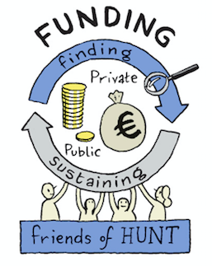
4. Funding
Continue to request and gain funds from public sources, national, regional and European.
Work with Limerick Chamber of Commerce Marketing Collective to create and execute a plan to increase patronage
Collaborate with the Friends to maximise membership and fundraising
Employ a Business Developer to fundraise overseas and increase sponsorship.
Request funding for continuation of Community Coordinator & Education Assistant.
Increase Retail revenues by 10%
Funds of €40K raised for new showcase gallery
Funds of €50K raised for garden
Funds of €50K for Summer Exhibition
Action 1. A new corporate events programme of workshops and tours for company away-days.
Action 2. Re-invigorate patronage of the museum, through private events and branding opportunities, working with the Limerick Chamber of Commerce Marketing Collective.
Action 3. A Friends driven set of activities to increase support across all age groups.
Action 4. Build strong relationships with potential overseas funders
KPI’s: Public Funds increase by 10%
20 patrons are signed up
Sponsorship database in place
Increase Retail revenues by 10%

Slide 80
Priority 4. Funding
Responsible: Rosemarie/ Jill Timeline:: 2019 Budget: Museum
T5.3 Continue to request and gain funds from public sources, national, regional and European.
T5.3.2 Work with Limerick Chamber of Commerce Marketing Collective to create and execute a plan to increase patronage Q1-4
T5.3.3 Collaborate with the Friends to maximise membership and fundraising Q1-Q4
T5.3.4 Employ a Business Developer to fundraise overseas and increase sponsorship. Q1
T5.3.5 Ensure funding for continuation of Community Coordinator & Education Assistant. Q2
T5.3.6 Apply for Creative Ireland and CEF Grants and others Q1-4
T5.4 Funding for Conservation
T5.4.1 Apply for funding under Heritage Council grants - Naomi - Q3
T5.5 Corporate Sponsorship and Grants
T5. 5.1 Corporate Grants
T5.5.2 Media sponsorship
Funds of €40K raised for new showcase gallery
Funds of €50K raised for garden
Funds of €50K for Summer Exhibition - under Summer Exhbition

Slide 81
Funding: Retail
Responsible: Joni Timeline:: 2019 Budget: Museum
T6.1 EPOS system upgraded and fully integrated with accounts systems
T6.1.1 Gather requirements for upgrading of the EPOS Feb 2019
T6.1.2 Agree requirements and budget with EPOS company and accounts Feb 2019
T6.1.3 Create and implement project plan and timeline for the upgrading of the EPOS Feb-Mar 2019
T6.1.4 Get training in all aspects of Epos system for Front of House- Feb ‘19 Mar 2019
T 6.2 Retail Offering- Shop
T6.2.1 Source stock and develop products to match exhibitions and Hunt Collections and relate to the six top best sellers in 2018 Q2
T6.2.1.1 Attend Showcase, RDS and visit four other museum shops and visitor attractions
T6.2.1.2 Online product research (e.g.: Maison et objet and Museums and Heritage Show) .
T6.2.1.3 Source/develop twenty replicas of items in the Hunt Collection
T6.2.1.4 Investigate and implement new promotion mechanisms for the shop
T6.2.2 Investigate becoming a Retail Partner with the Craft and Design Council of Ireland to partake in their merchandising, promotional activities and staff training programmes and be listed as a stockist on their websites Q2

Slide 82
Funding: Retail
T6.3 Online sales
T6.3.1 Reorganise website to promote admissions and catalogue sales Q1
T6.3.1.2 Research and evaluate online shops for museums Q2
T6.3.2 Investigate selling unique products via Etsy Q2
T6.3.2 Increase our social media presence for retail items Q1-Q4
T6.4 Retail Display
T6.4.1 Develop area in shop for Contemporary Ceramics to compliment the in-house Contemporary Ceramic Collection and the artists featured in time for Colin Sears Exhibition Q3
T6.5 Admissions & Front of House
T6.5.1 Enhance Front of House Customer Service giving optimum care and attention to each visitor to encourage repeat business Q1-4
T6.5.2 Investigate costs of attending Failte Ireland’s courses:
Accredited Service excellence programme- 1 day
Enhance Your Management and Supervisory Skills- subsidised, 2 days
‘Merchandising for Visitor Attractions’, 2 days in Galway

Slide 83
MarComms
Marketing and Communications is a service for all 4 priorities and tasks
MarComms is responsible for website maintenance and development
MarComms is responsible for all Social Media Platforms
KPI’s: Website traffic increase of 10% on 2018
Social Media platforms to show 20% increase on 2018
Notes:
Community is our key platform for participation and organic growth. The Hunt Museum brand attracts a significant and loyal Friends’ network with a considerable number of people who have been associated with the museum for decades. They carry out work, fundraise and support and promote the museum and its activities. We also have a thriving Docent programme, with expert volunteers informing visitors about our objects, giving tours and working on projects. We work with local community initiatives such as mental health groups and traveller people.

Slide 84
MarComms
Responsible: Julie Timeline:: 2019. Budget: Museum
T7.1 Marketing Communication Plan for Exhibitions
T7.1.1 Marketing Communication plan to completed for each exhibition - to include web presence, press and media coverage and mailouts.
T7.1.1.1 Social Media plan created & executed
T7.1.2 Design and print of collateral for each exhibition
T7.2 Marketing Communication Plan for Events
T7.2.1 Marketing Communication plan to completed for each event - to include web presence, press and media coverage and mailouts.
T7.2.1.1 Social Media plan created & executed
T7.2.2 Design and print of collateral for each event
T7.3 Marketing Communication Plan for Event Guide
T7.3.1. Liaise with all departments for dates and details of all upcoming events, add to website, share with Limerick.ie
T7.3.1 Design Event Guide, proof, print arrange distribution and add online. Post Docent Blog

Slide 85
Website
Responsible: Julie Timeline:: 2019. Budget: Museum
T7.4 Website content, maintenance and minor improvements
T7.4.1 Content: upcoming events, online exhibitions, blogs, curators choice, Printmaker, Events Guide, education pages, community pages, e-commerce for event and tour booking. Open times highlighted for public holidays and any changes. Banners changed according to exhibitions. - a weekly schedule to be kept and updated.
T7.4.2. SEO is to be optimised regularly to improve organic traffic.
T7.4.3 Navigation and links to be reviewed and maintained quarterly
T7.4.4 Website stats to be maintained monthly and reported quarterly
T7.5 Develop new website with new branding Q3/4

Slide 86
Social Media
Responsible: Julie Timeline:: 2019. Budget: Museum
T7.6 Social Media Review and Planning
T7.6.1 Research into best practice by comparable institutions: Q1 and Q2
T7.6.2 A plan for each social media platform to be created and executed against the research, Q1 & Q2
T7.6.3 Monthly statistics to be maintained and quarterly reports.
T7.6.2 Review of Progress and revisions made Q3 and Q4

Slide 87
FRIENDS Operational Plan 2019
Notes:
These are the overall goals
Which translate to the following tasks for the year.

Slide 88
Key Platform Actions
Increase membership of Friends from 265 subscriptions to 500, including 50 in Hunt Society
Create mental health association partnership
Link to Corporate Subscriptions
Notes:
These are the overall goals
Which translate to the following tasks for the year.

Slide 89
Priority related actions:
Priority 1. Collections
Goal:
link Friends Lectures more closely to the Collections
Priority 2: Public Engagement: Visitors, Education, Community, Participation
Goals:
Year long activism campaign with Hunt Society volunteers to promote the benefits of culture heritage and participation for mental Health
Active promotion and participation in events
Priority 4: Funding:
Maximise membership and fundraising
Raise €20K in non subscription funds linked to support of Limerick Mental Health
Notes:
These are the overall goals
Which translate to the following tasks for the year.

Slide 90
7.1. Key Platform Action: Increase Membership
Goal: Expand membership of Friends from 265 subscriptions to 500, including 50 in Hunt Society
Three actions:
Diversify and internationalise the base
Creation of young activist group
Renew memberships & Activate dormant subscriptions

Slide 91
T7.1 A. Diversify and internationalise the Friends Base
Responsible: Julie Date: February - June 2019 Budget: Friends Association
Tasks
T7.1.A.1 Finalise new Friends Brochure end February
T7.1.A.2 Set up and execute online marketing campaign to promote Friends activities and membership February - May
T7.1.A.3 Create reciprocal relationships with Friends schemes in similar institutions worldwide e.g. Frick, Burrell, March 2019
T7.1.A.4 Offline: Create flyer(s) for distribution in Cafe and around Limerick at cultural heritage venues and by attendees at Lecture to their local libraries etc. Q1
T7.1.A.5 Offline: Work with shop staff to sell membership to visitors. Q1
T7.1.A.6 Have a manned Friends desk at majority of Hunt events: openings, activity weeks etc.

Slide 92
T7.1.B Creation of young activist group
Responsible: Julie Date: February - June 2019 Budget: Friends Association
Tasks
T7.1.B.1 Create an online volunteers leaflet under the banner of the Hunt Society. end February
T7.1.B.2 Set up and execute online marketing campaign to volunteering in exchange for membership, link to Mental Health campaign February - May
T7.1.B. 2.1 work with EdSpark to set up a TY certified volunteer hours module
T7.1.B.3 Schedule in attendance at University and School Fares, recruitment drive - September

Slide 93
T7.1.C Renew Membership & Activate Dormant Subscriptions
Responsible: Julie
Date: February - June 2019
Budget: Friends Association
Tasks
T7.1.C.1 Set up and execute a campaign to renew all subscriptions as standing orders: weekly mail-outs to non-subscribers, detailing benefits and need for subscription. February - April
T7.1.C.2 Work through mailing list targeting 50 possibles per week to retake up membership. February to June
T7.1.C.3 Member:- “Bring in a member campaign” - April to September

Slide 94
7.2. Key Platform Action: Partnership
Create mental health association partnership

Slide 95
T7.2. Create mental health association partnership
Responsible: Jill
Date: January - February - 2019 Budget: Friends Association
Tasks
T7.2.1 Investigate possible partnerships.
T7.2.2 Create joint campaign, using scheduled events and agreed fundraisers - end February
T7.2.3 Announce Partnership - end of March
T7.2.4 Create plan of fundraising targets and activities with mental health partner. Link to T7.4 March-December 2019
T7.2.5 Execute campaign. March-December 2019

Slide 96
Key Platform Linked Action:
Link to Corporate Subscriptions
A new community of corporate subscriptions to be developed under the Hunt Museum will be investigated and implemented and the relationship to the Friends made clear.

Slide 97
Priority 2. Public Engagement: Education
Goal:
Link Lectures more closely to the Collections - priority 1
Year long activism campaign with Hunt Society volunteers to promote the benefits of culture heritage and participation for mental Health
Active promotion and participation in events
Actions:
Lunchtime Lecture Series
Campaign with Hunt Society and Association and Mental Health Association
Plan of events for 2019
Actively promote events and increase numbers attending events

Slide 98
T7.3 Friends Lunchtime Lecture Series
Responsible: Julie
Date: February - May 2019
Budget: Friends Association
Tasks
T7.3.1 E. Hanrahan to research and confirm speakers for each month a quarter year ahead
T7.3.2 Confirm dates & location of talks
T7.3.3 Lecture details to be shared to members via Newsletters, on Facebook Pages, and public via email, post, and website

Slide 99
T7.4 Campaign with Hunt Society and Association and Mental Health Association
Responsible: Julie
Budget: Friends association
Tasks
T7.4.1 Set up and execute a series of activities Date: March- December 2019
T7.4.2 Create and execute physical & online campaign with Hunt Museum Society / to include flyer, and website
T7.4.3 Cross link to membership by introduce campaign into UL, LIT, Mary I and schools to build up members

Slide 100
T7.5 Plan of events for 2019
Responsible: Julie
Date: to be complete before Q2
Budget: Friends association
Tasks
T7.5.1 Events to include: Lectures, talks, clubs, dinners, luncheons, and outings
T7.4.1.1 E Hanrahan to provide Lunchtime lecture details. J Noonan to confirm Silver Circle Dates. M O’Flaherty to confirm Book Club dates.
T7.5.2 Outings to be decided and confirmed for 2019
T7.5.3 Annual Fundraising lunch (to include actions that raise funds for Summer Exhibition)
T 7.5.4 Events guide to be designed and produced for circulation to all Friends to be used to provide prospective members with overview of events taking place

Slide 101
T7.6 Actively promote events and increase numbers attending events
Responsible: Julie
Budget: Friends association
Tasks
T7.6.1 Mailing list:
T7.5.1.1 Resolve GDPR email issue by the beginning of Q2
T7.5.1.2 Implement Friends event mail out procedure - end February
T7.6.2 Create design template for Friends events for online and print marketing - Q2
T7.6.3. Increase the participation by Friends on Hunt Museum Facebook pages, by Q4
T7.6.3.1 Developing groups for workshops - Silver circle etc by Q2
T7.6.3.2 Create Friends posts on Hunt Museum Facebook pages re events. Q2-Q4
T7.6.4 Develop a Friends Linked-In Group by Q2
T7.6.5 Maintain Friends Website Pages Q1-Q4

Slide 102
Priority 4: Funding:
Goal:
Maximise membership and fundraising
Raise €20K in non subscription funds
Actions: JP McManus Golf Am Pro - Museum in a Garden Project
€20K Campaign on Hunt Museum & Mental Health (covered under Task 7.2)

Slide 103
T7.7. JP McManus Golf Am Pro
Responsible: Jill (And Friends Volunteer, Yvonne McGann)
Date: January - February - 2019
Budget: Friends Association
Tasks
T7.7.1 Submit application form to JP McManus end January 2019
T7.7.2 Convene Committee meetings to organise promotion and set up teams Q1-Q3
T7.7.2.1 Recruit players
T7.7.3 Run event Hunt Golf Tournament September 2019 Q2-Q3

Slide 104
Overview of Docent Projects & Activities
Collections: Conservation
Collections: Collection Management System data improvements
Collections: New Tour Booklet
Collections: Labelling & Timeline
Collections: Blogging (& Vlogging)
Visitors: Catalogue Research Lavery/Osborne
Visitors: Tours Lavery/Osborne
Visitors: Invigilation Lavery Osborne
Education: Primary - Revised and new tours
Education: Post-Primary - Revised and new tours
Education: Lavery Osborne primary & post primary workshops
Education: Heritage & Science Weeks
Community: Dementia Programme
Community: Partnership on activities with Limerick Mental Health
Community: Monthly Arts & Crafts
Participation: Limerick 3D Digitisation
Notes:
For the 3 platforms the impacts we want to have for 2019, and therefore the areas or objectives we will concentrate on for the year, are proposed as follows
These are the overall goals
Which translate to the following tasks for the year.

Slide 105
Overview of Docent Projects & Activities
Collections: Care of Collections and Conservation 3x/year and new Docent Training - Autumn, Winter, Spring Q2 - Naomi
Collections: Collection Management System data improvements Q2 - Tori
Collections: New Tour Booklet Education - look at sections
Collections: Labelling & Timeline Q1
Collections: Research Projects Q1
Collections: Blogging (& Vlogging) Q1
Visitors: Catalogue Research Lavery/Osborne Naomi Q1/2
Visitors: Tours Lavery/Osborne - schedule Naomi/Sam
Visitors: Invigilation Lavery Osborne -schedule Naomi/Sam
Visitors: Tours - where and what should be said about the Docents
Notes:
These are the overall goals
Which translate to the following tasks for the year.

Slide 106
Overview of Docent Projects & Activities
Education: Primary - Revised and new tours
Education: Post-Primary - Revised and new tours
Education: Lavery Osborne primary & post primary workshops
Education: Heritage & Science Weeks
Community: Dementia Programme - Analysis of what works and doesnt - Joni/Moira Q1
Community: Partnership on activities with Limerick Mental Health - Q2
Community: Monthly Arts & Crafts - Joni, Moira/Lorraine, Ann O’Connell, Vera
Participation: Limerick 3D Digitisation - Education
MSPI - how Docents should be contribution and informed about it.
Docent Training - why, what, where, when from Docents for grant application/sponsorship -
Create 2020 Docent Operational Plan Q4
Notes:
These are the overall goals
Which translate to the following tasks for the year.

Slide 107
Our KPI’s based on our desired impacts
Notes:
So starting with our Strategic Ambitions or where we are looking to have an impact.
These all link to the UN Sustainable Development Goals and the UN Live Museum as we needed to show a relationship to larger world goals to get senior management in the City - the CEO of the council etc to understand how the museum can help them change lives. These loftier goals make people feel part of something - they aim to impart the why of working with us. And to be taken seriously we have to be able to prove the connection between our actions and change.
Actually all 3 are relevant to regeneration. We might help change an area physically but we also have to bring people with us so they feel part of it and don’t undo the work being done.

Slide 108
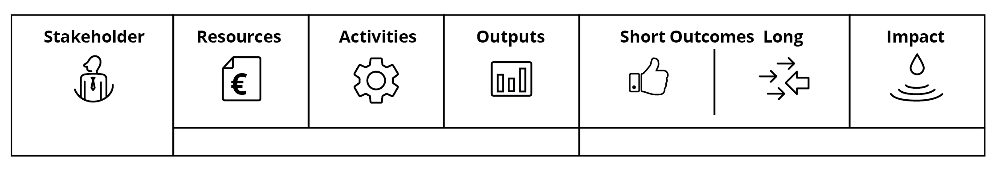
KPI’s activities, outputs, impacts
Each of our four priorities need a long term desired impact that reflects the change we want to effect.
Output Education: double number of schools coming to the museum in 2019
ADD KPI’s
Notes:
We start with the statement and then next time round as part of our creating the Business or Operational Plan for 2019 we will work out outcomes / outputs, the activities - leading on from our Key Actions and resources that we need in place to achieve our aimed for 2025 Impact

Slide 109
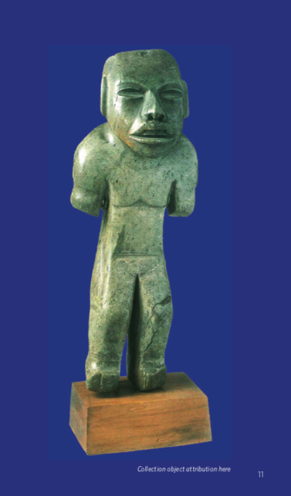
Budget : to add
Notes:
Describing

Slide 110
Operational Plan 2019
Next steps:
Comments by Board to be sent by 10 January to Director@huntmuseum.com
Each Department will detail their tasks for the year, allowing us to create an overall planning and increase coordination by 14 January
Final version with final budget and some KPI’s will be presented at our Board meeting of 24 January for approval
Notes:
Describing

Slide 111
Friends Operational Plan 2019
Next steps:
Tie into Business Plan 2019 in areas outlined
Schedule activities and campaigns for 6 months ahead
Fundraising: membership and JP McManus
Friends: Link Friends Lectures more closely to the Collections
Funding: Fundraising Dinner and Event June 2019 - coinciding with opening of Summer
Exhibition; sponsorship is needed for the exhibition. Friends to support.
Notes:
Describing

Slide 112
Instructions
The following pages have a person responsible for the operational area and are grouped under the priorities to make the direct link to the Strategic Plan.
For each priority take what is written above (if correct, or change if not) and create the more detailed task(s) that sit under it .
Add each task individually with a date of delivery, and budget line, create subtasks where needed. Don’t overcrowd slide, add a new one if needed. If you have an idea of magnitude, i.e. number of visitors expected, number of Friends, number of schools, number of objects digitised please add against the task.
T1.1 PRIMARY TASK
Budget: ADD THE PROJECT CODE OR BUDGET LINE
Date: OF DELIVERY OR IF ONGOING STATE.
T1.1.1 ADD SUBTASK
T1.1.2 ADD SUBTASK
T1.2 PRIMARY TASK
REPEAT….

Slide 113
Priority 1. Collections
http://expatpensionreview.com/Pensions-Abroad.pdf

